Slide 1

Adopted from MIT Course
ELECTRIC CURRENT
FISIKA DASAR 2

Slide 2
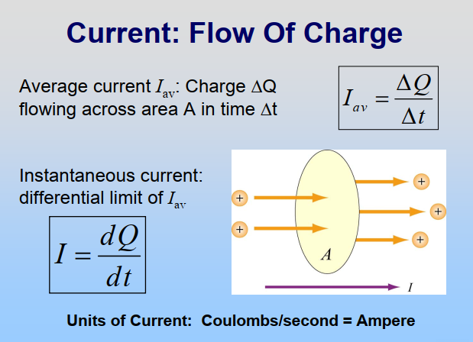

Adopted from MIT Course
2

Slide 3
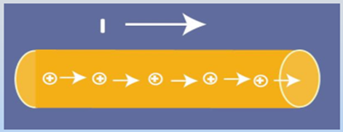
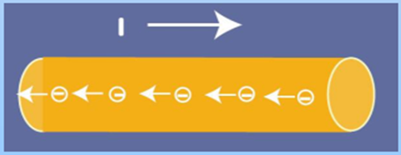
Direction of The Current
Direction of current is direction of flow positive charge
or, opposite direction of flow of negative charge
Adopted from MIT Course
3

Slide 4
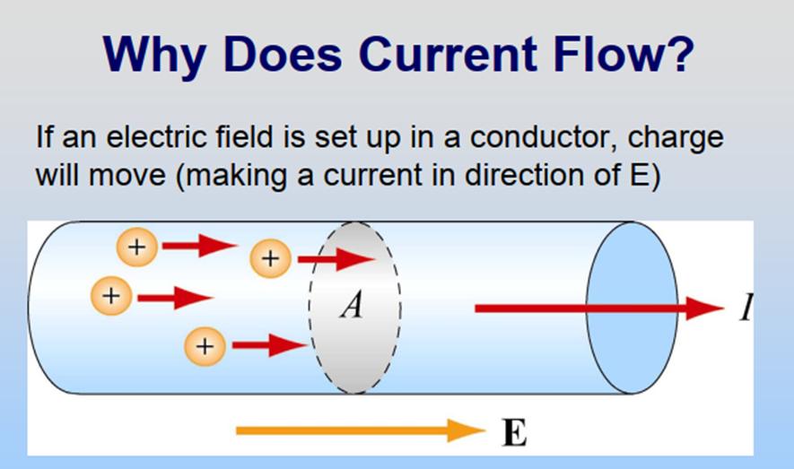
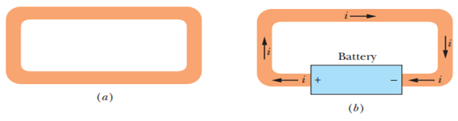
Source: Fundamentals of Physics, Halliday & Resnick
Adopted from MIT Course
4

Slide 5
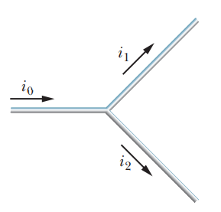
Branch Current
If an electric current flows in a branch, it will follow the rules:
Σ_{inflow} = Σ_{outflow}
This expression is known as “law of conservation of electric charge” and is also known as “Kirchoff’s law 1”
i_{o} = i₁ ₊ i₂
Adopted from MIT Course
5

Slide 6
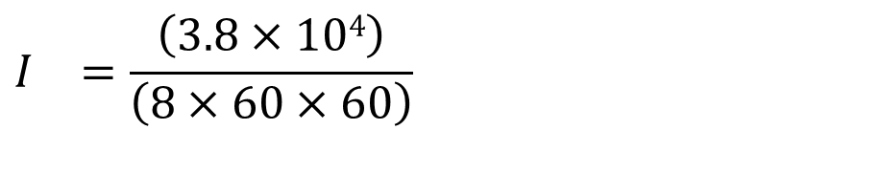


Example 1
Over the course of an 8 hour day, 3.8×10⁴ C of charge pass through a typical computer (presuming it is in use the entire time). Determine the current for such a computer.
Answer:
$$I_{}=\frac{Q}{t}$$
$$I_{}=\frac{\left(3.8×104\right)}{\left(8×60×60\right)}$$
$$=1.3 A$$

Slide 7
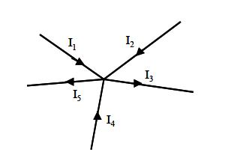
Example 2
If the amount of inflow current I₁ = 2A, I₂ = 5A, I₄ = 3A and the amount of outflow current I₃ = 6A, what is the current value of I₄?
Answer:
Σ_{inflow} = Σ_{outflow}
I₁ + I₂ + I₄ = I₃ + I₅
2 + 5 + 3 = 6 + I₅
I₅ = 4 A

